Slide 1

Using Machine Learning to Predict Heart Disease
Group 2
Yonatan Gorin
Desiree Joseph
BethAnn Wilde
June 12, 2023

Slide 2

Heart disease is the leading cause of death for men, women, and people of most racial and ethnic groups in the United States. One person dies every 33 seconds in the United States from cardiovascular disease. About 695,000 people in the United States died from heart disease in 2021—that’s 1 in every 5 deaths. Heart disease cost the United States about $239.9 billion each year from 2018 to 2019. This includes the cost of health care services, medicines, and lost productivity due to death. Heart Disease Facts | cdc.gov
Why Heart Disease

Slide 3
The Process of using Machine Learning to Predict Heart Disease
Found dataset related to heart disease
Conducted exploratory data analysis to try to understand dataset, different factors and relationships
Created machine learning models to predict heart disease
Looked at the results and made recommendations

Slide 4
The Dataset
Found on Kaggle.com https://www.kaggle.com/datasets/johnsmith88/heart-disease-dataset
Citation Janosi,Andras, Steinbrunn,William, Pfisterer,Matthias, and Detrano,Robert. (1988). Heart Disease. UCI Machine Learning Repository. https://doi.org/10.24432/C52P4X
Donated June 1988. Names and SSNs removed later.
Data from Cleveland – 14 attributes

Slide 5
The Dataset Attributes
Age in years
Sex (1 = male, 0 = female)
Chest pain type (1 = typical angina, 2 = atypical angina, 3 = non-anginal pain, 4 = asymptomatic)
Resting blood pressure (in mm Hg on admission to the hospital)
Serum cholesterol in mg/dl
Fasting blood sugar > 120 mg/dl (1 = true, 0 = false)
Resting electrocardiographic results (0 = normal, 1 = ST-T wave abnormality, 2 = probable or definite left ventricular hypertrophy)
Maximum heart rate achieved
Exercise induced angina (1 = yes, 0 = no)
ST depression induced by exercise relative to rest
Slope of the peak exercise ST segment (1 = upsloping, 2 = flat, 3 = downsloping)
Number of major vessels colored by fluoroscopy (0 to 3)
Thallium heart scan (0 = normal, 1 = fixed defect, 2 = reversable defect)
Heart disease (presence/absence)

Slide 6
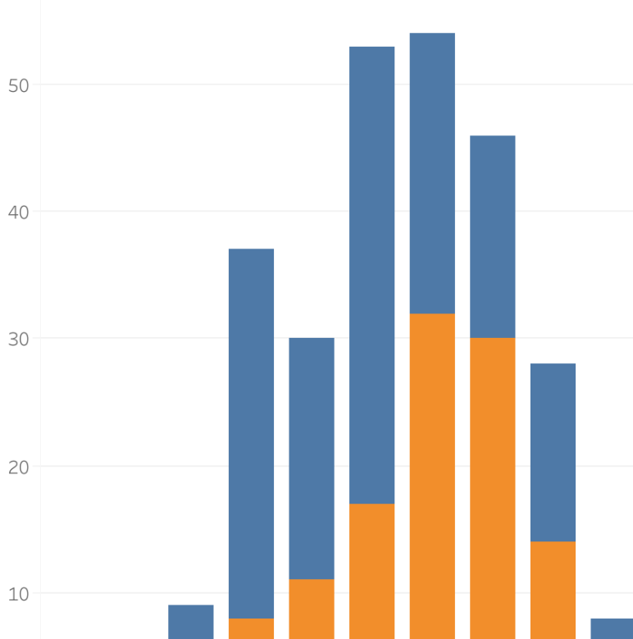
A Look at the Data (Exploratory Data Analysis)
The Story Starts Here

Slide 7
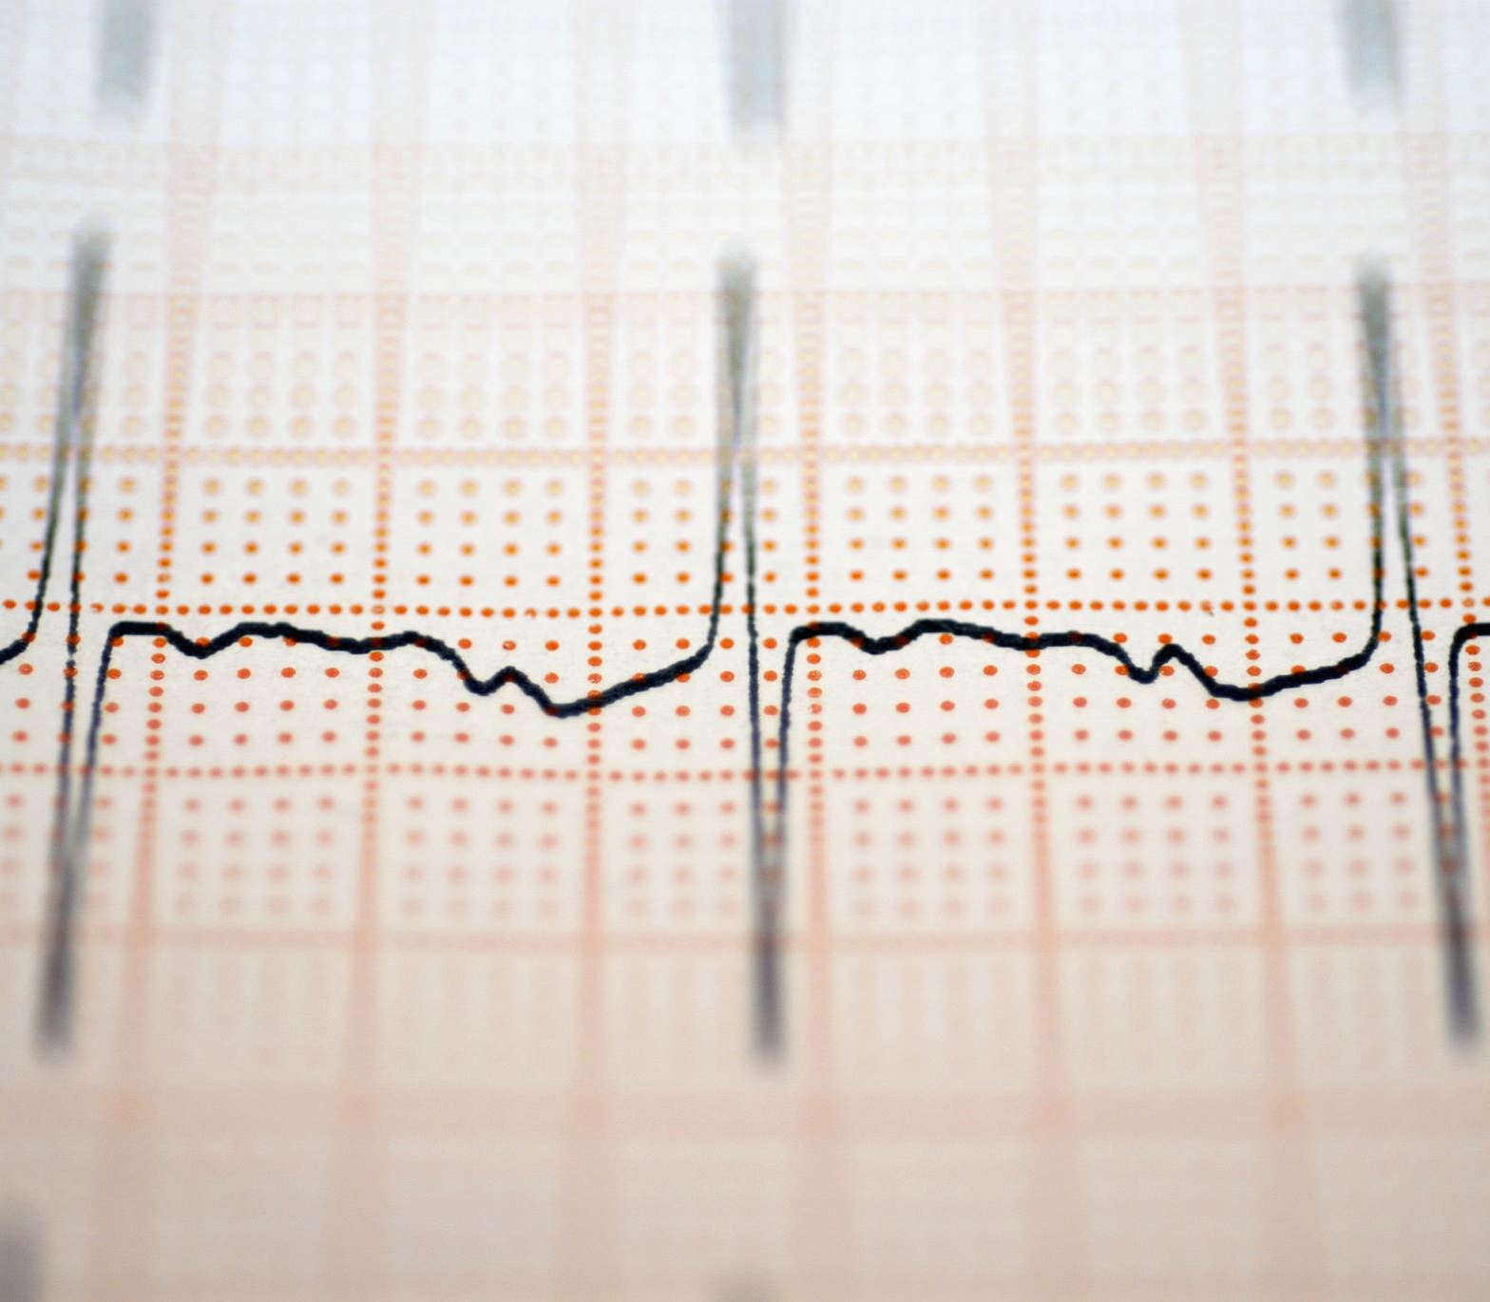
Multiple models were created to determine which was the most effective to predict heart disease. Supervised Learning Models: - Logistic Regression - Decision Tree - Random Forest - Support Vector Classifier (SVC) Neural Networks: - Sequential - Keras Tuner
Modelling Heart Disease

Slide 8
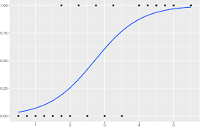
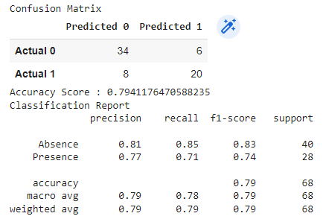
Logistic Regression
Logistic regression is a statistical method for predicting binary(0,1) outcomes from data.

Slide 9
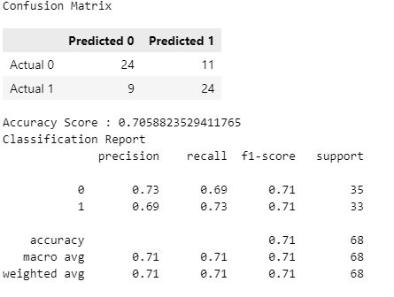
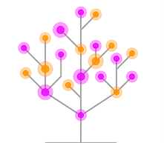
Decision Tree
A decision tree is a non-parametric supervised learning algorithm, which is utilized for both classification and regression tasks. It has a hierarchical, tree structure, which consists of a root node, branches, internal nodes and leaf nodes.

Slide 10
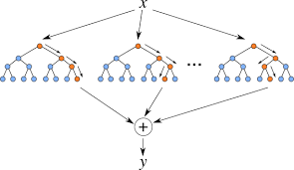
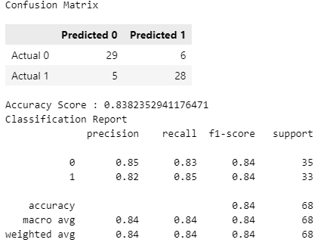
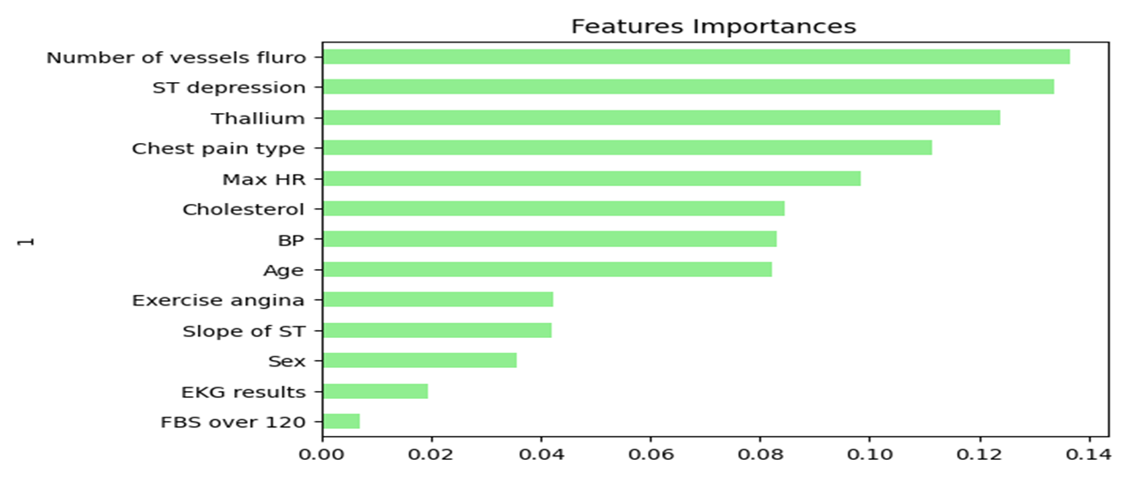
Random Forest
Random Forest is used for both classification and regression.

Slide 11
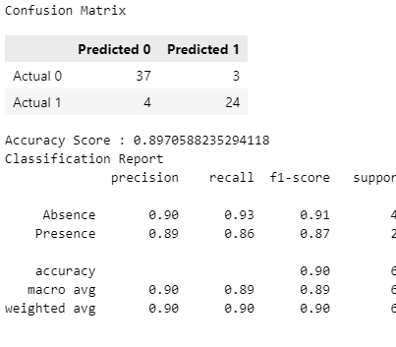
Support Vector Classifier (SVC)
SVC works by mapping data points to a high-dimensional space and then finding the optimal hyperplane that divides the data into two classes.

Slide 12
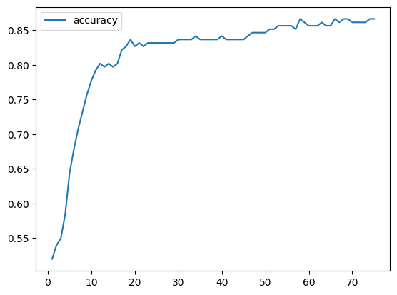
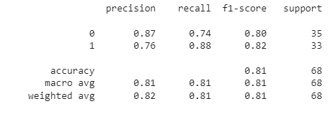
Sequential
A Sequential model is for plain stack of layers where each layer has exactly one input feature and one output target.

Slide 13
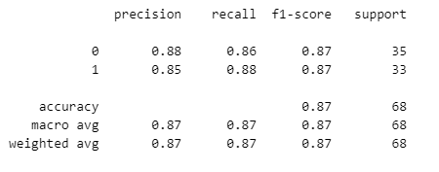
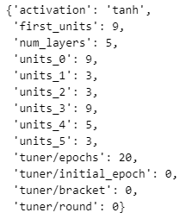
Keras Tuner
Keras Tuner is a library that helps pick the optimal set of hyperparameters.

Slide 14
Which Model would recommend to Predict Heart Disease
Support Vector Classifier results in the highest weighted F1 scores and the greatest Accuracy of all the models tested and is our Recommendation
F1 scores and Accuracy:
Support Vector Classifier (SVC)
.90
Keras Tuner - .87
Random Forest - .84
Sequential - .81
Logistic Regression - .79
Decision Tree - .71

Slide 15
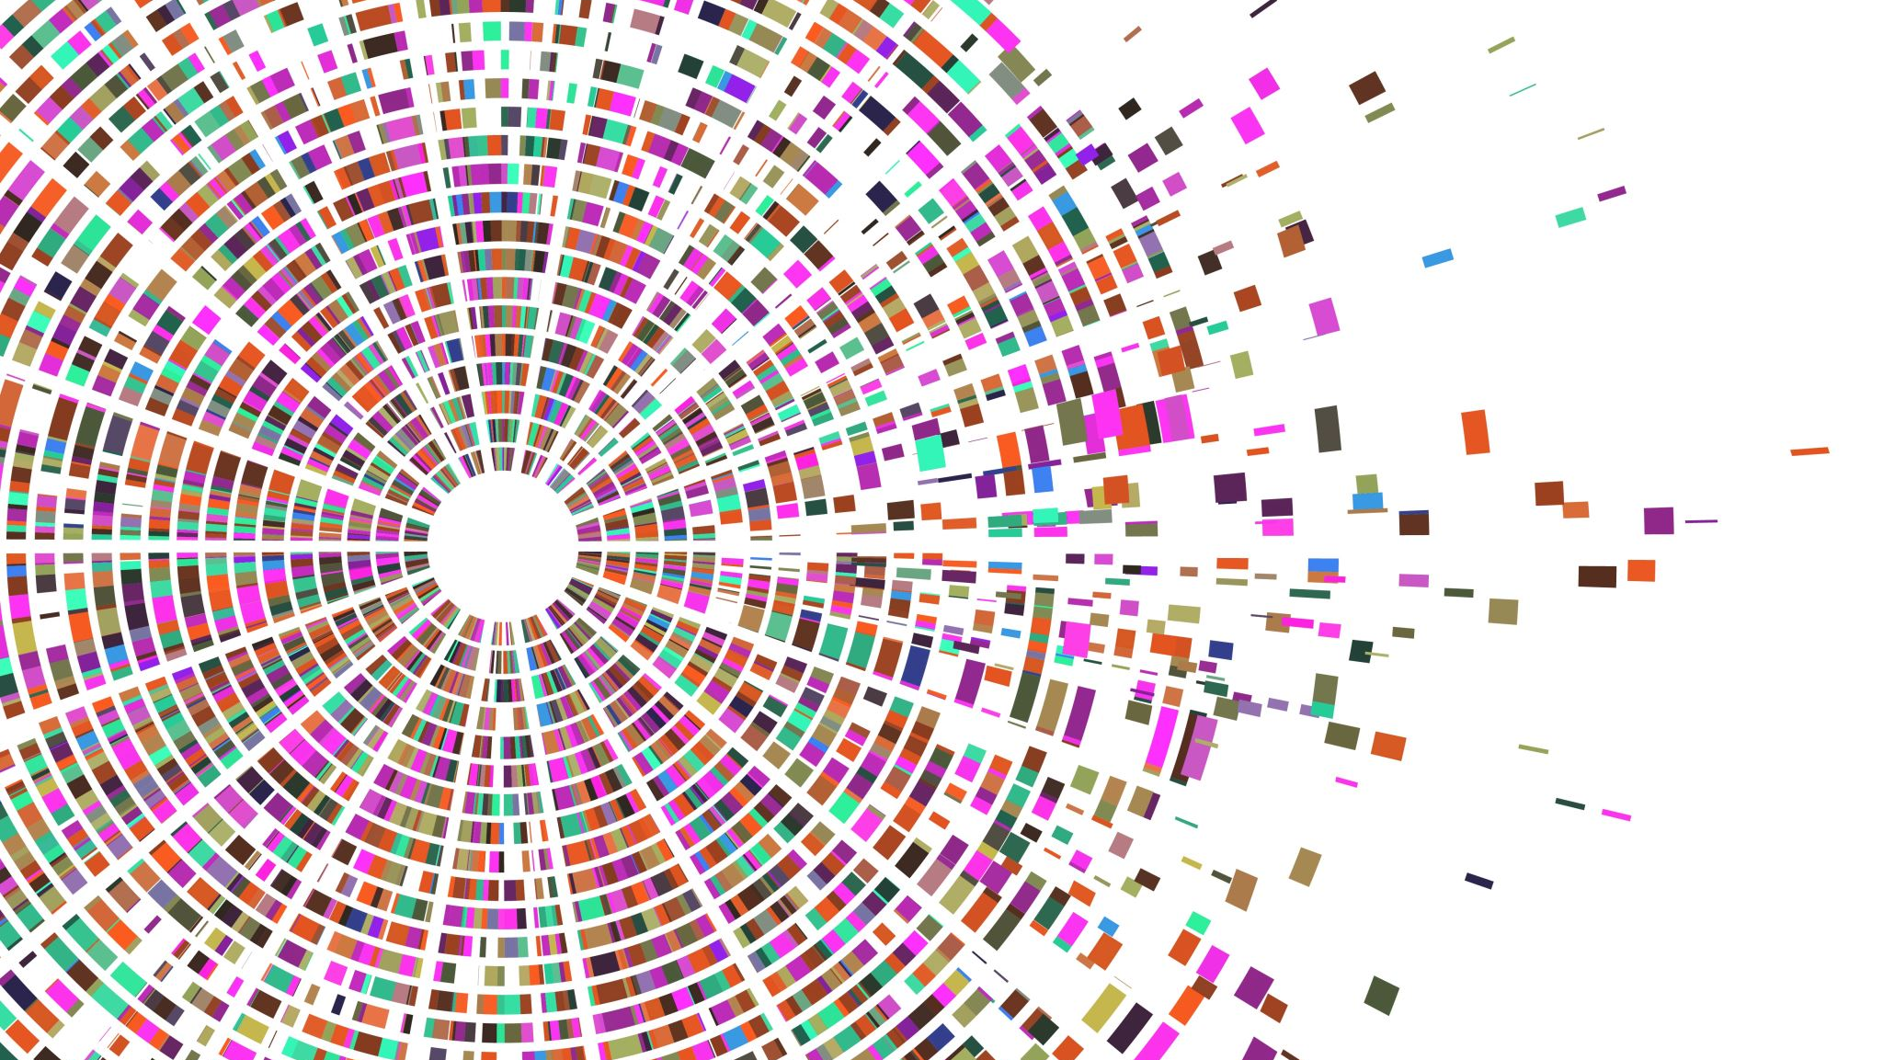
Thank You!
Q & A

